Slide 1
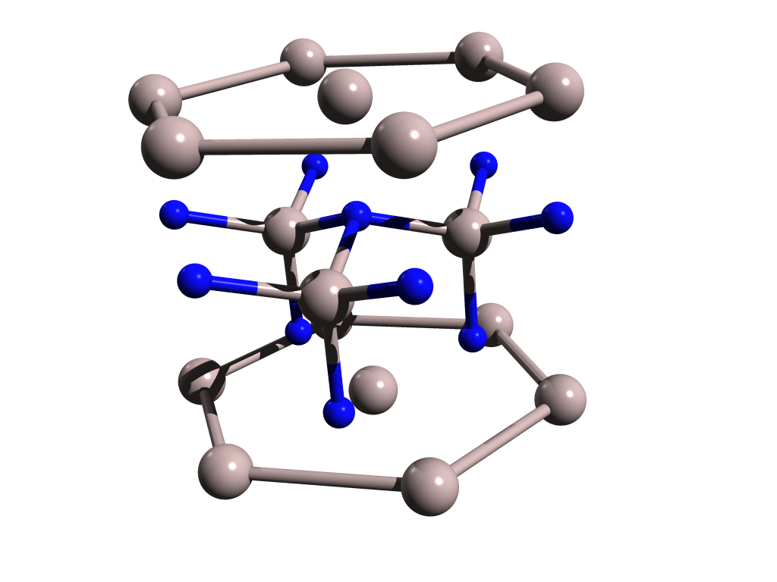
Al
4.975 Å
N
3.110 Å

Slide 2
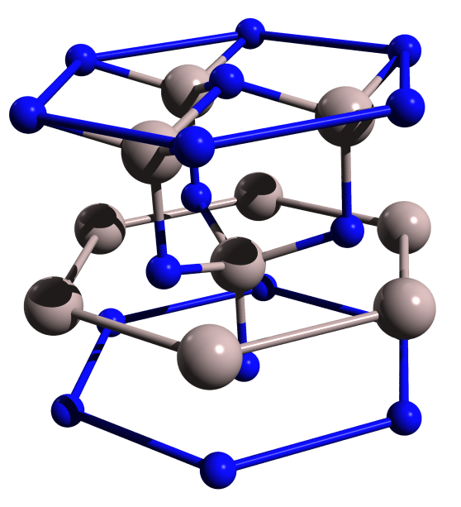
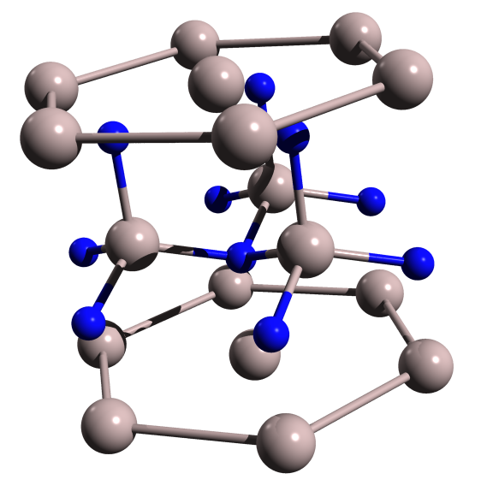
Nitrogen side
Aluminium side
N
4.975 Å
Al
3.110 Å

Slide 3
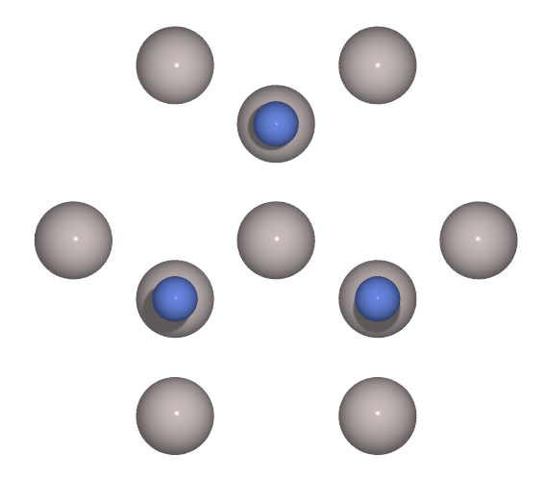
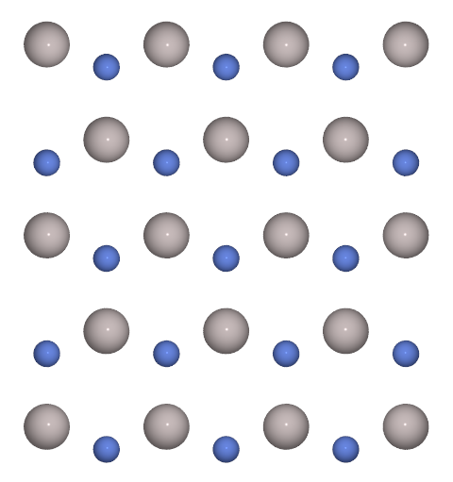
Plane A
AlN(00.1) face
Plane B
0°
32°
58°
N
Al
0°
58°
32°
AlN(00.-1) face

Slide 4
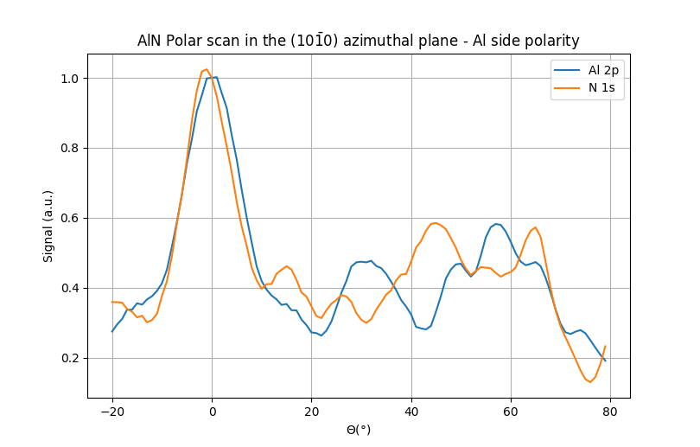
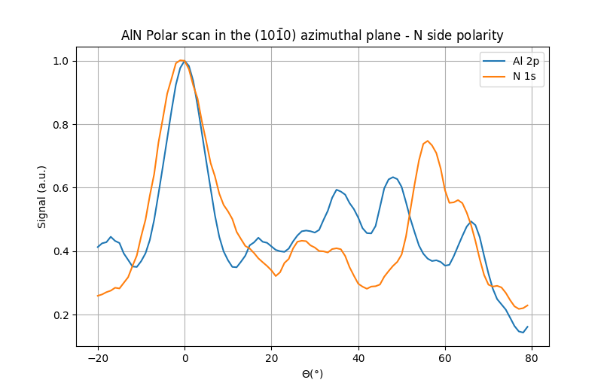

Slide 5
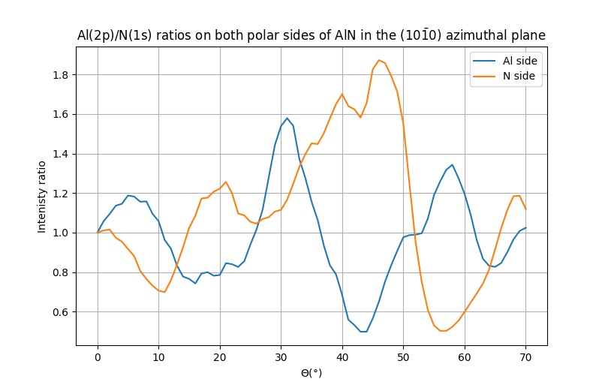

Slide 6
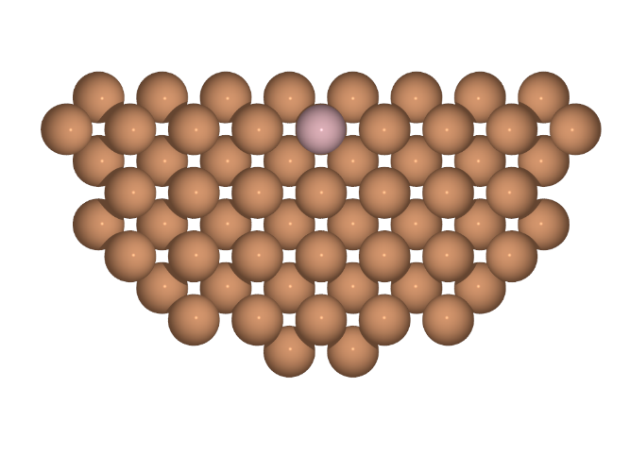
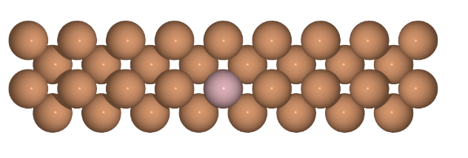
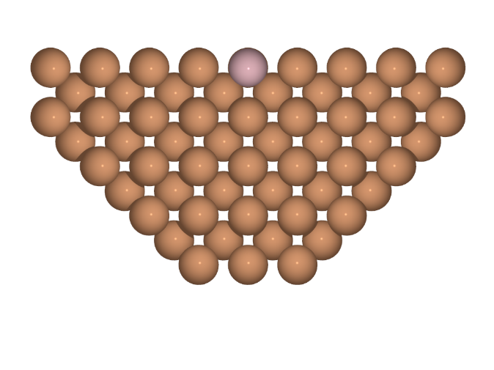
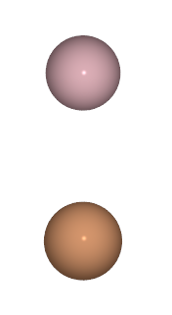
a)
b)
c)
Z direction
plane #0
plane #0
Z=0Å
4 planes
plane #3
The Fe emitter atom at x=y=z=0Å
plane #8
diameter < 25Å
Other Fe atoms of the cluster

Slide 7
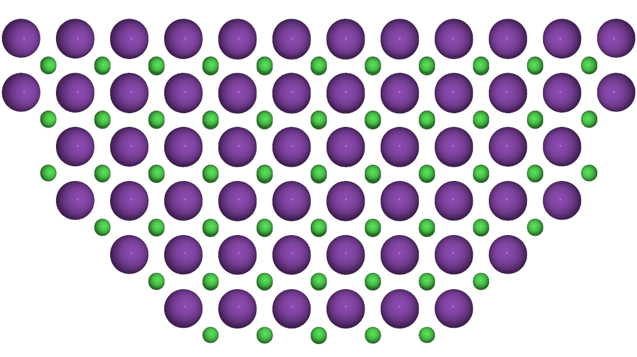
Cs
Cl
Chlorine emitter in third
plane

